Slide 1

Hemköp vs Mathem - a sales data analysis
By Gustav

Slide 2
Way of working
Web scraping
Data cleaning
Data analysis

Slide 3

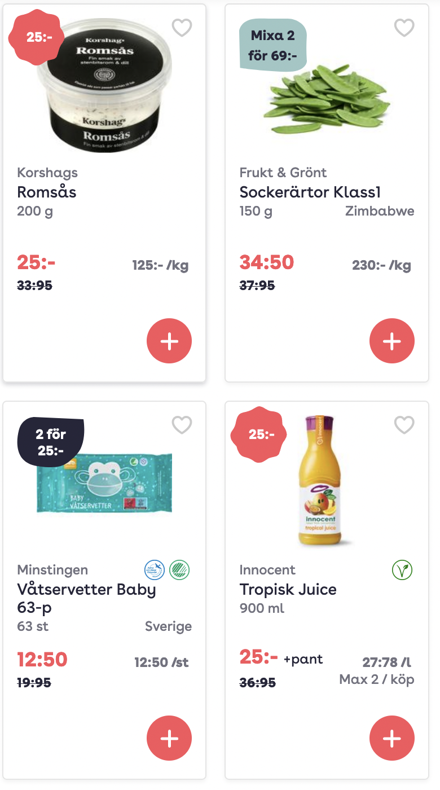
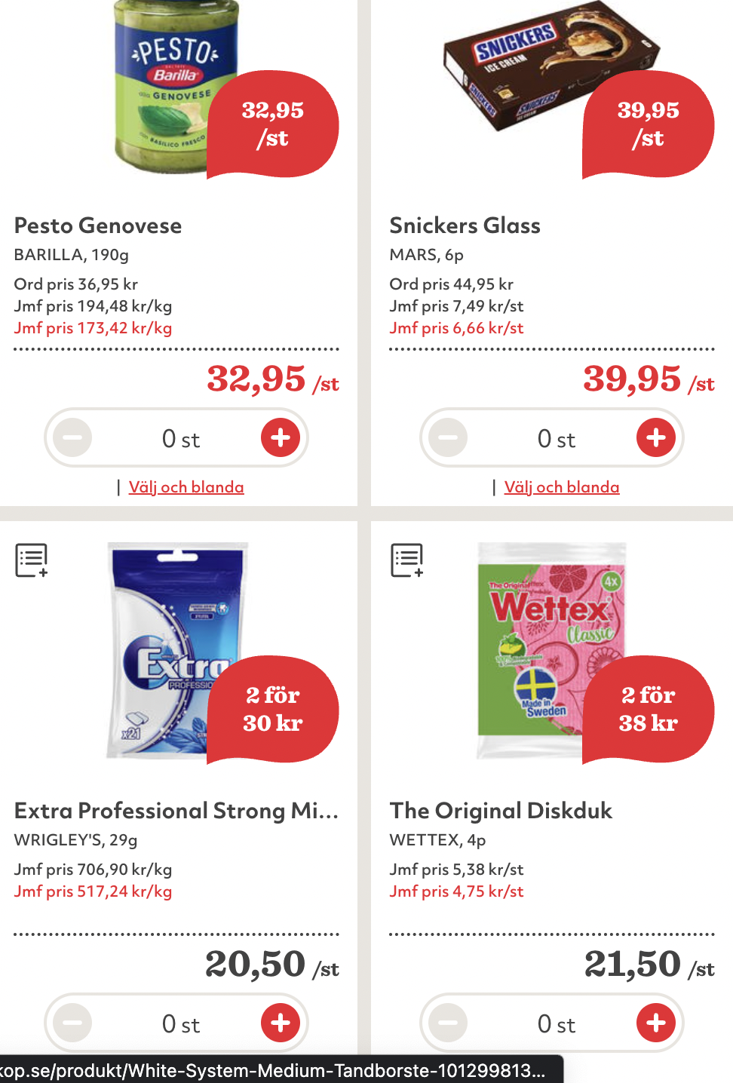
Web scraping
Selenium
Choice of webdriver
Expected conditions
Challenges

Slide 4

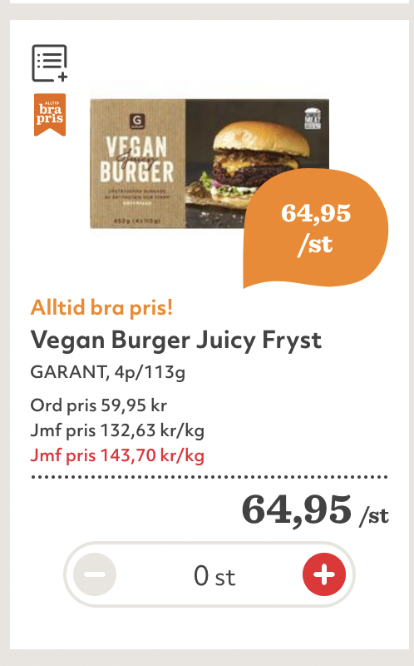
Data Cleaning
Outliers
Types
Removing chars
Extracting numbers

Slide 5

Data Cleaning
Outliers
Types
Removing chars
Extracting numbers

Slide 6
Data Cleaning
Outliers
Types
Removing chars
Extracting numbers
SCAM ALERT!!

Slide 7

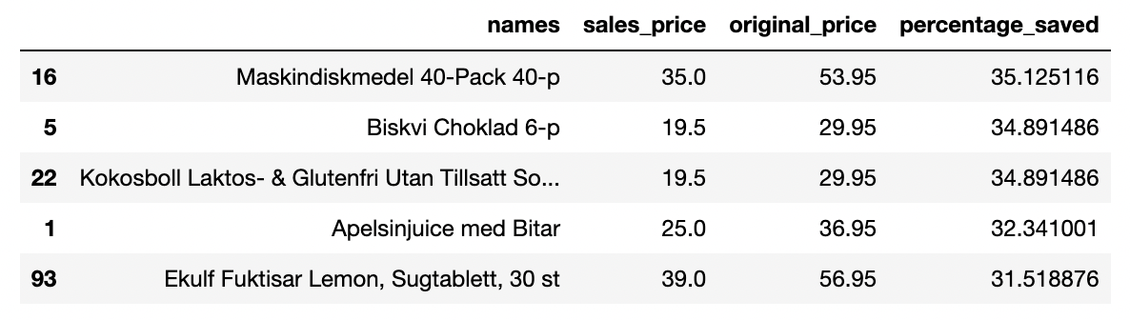
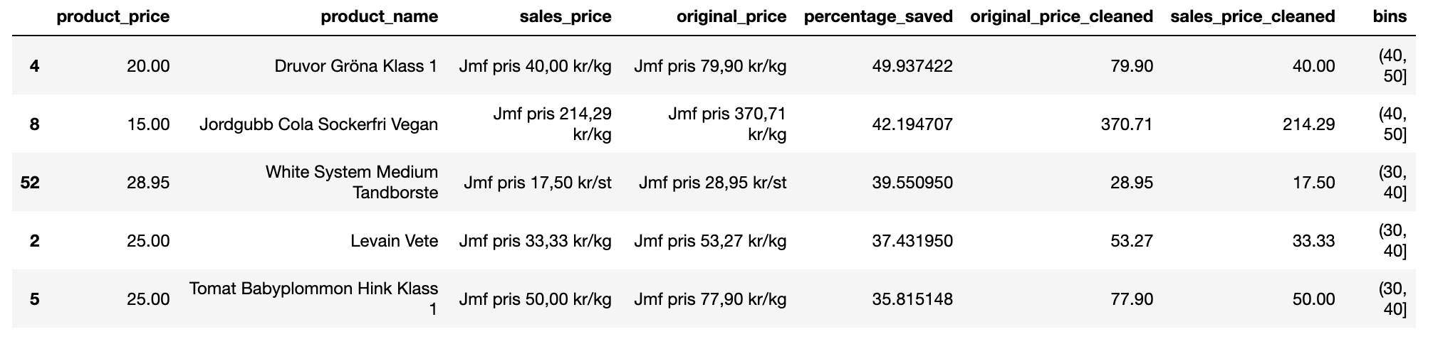
Data Analysis
Datasets:
Mathem:
Hemköp:

Slide 8
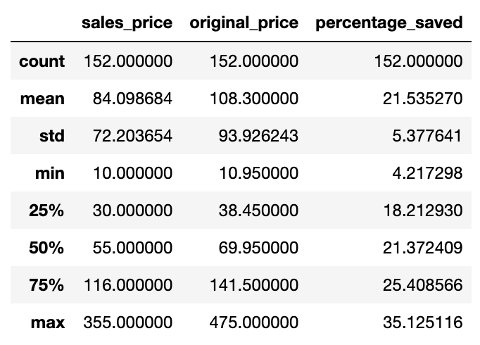
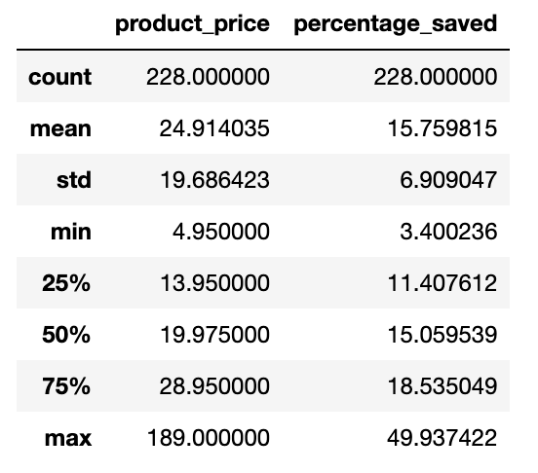
Data Analysis
Datasets:
Mathem:
Hemköp:

Slide 9
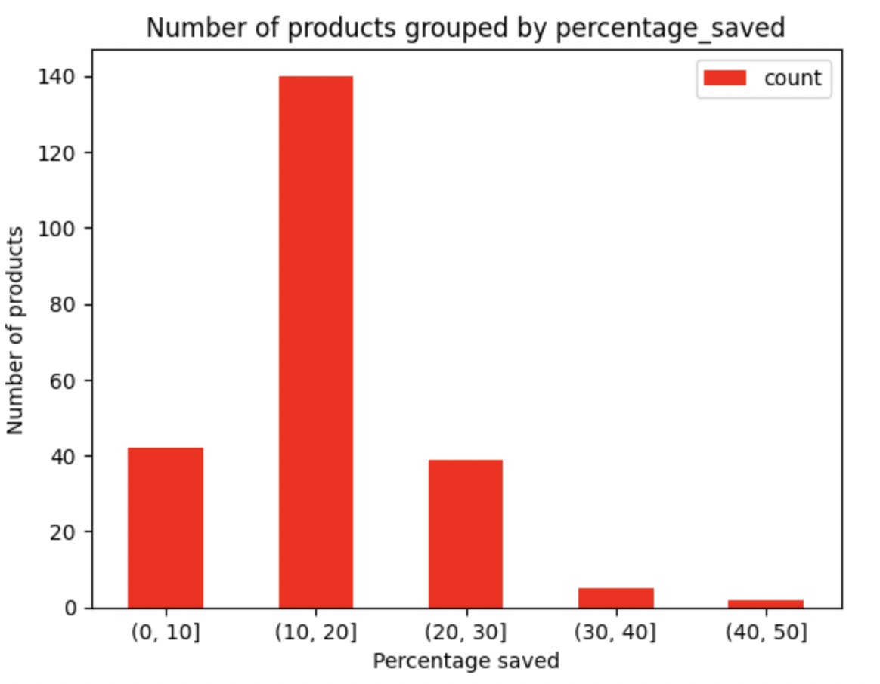
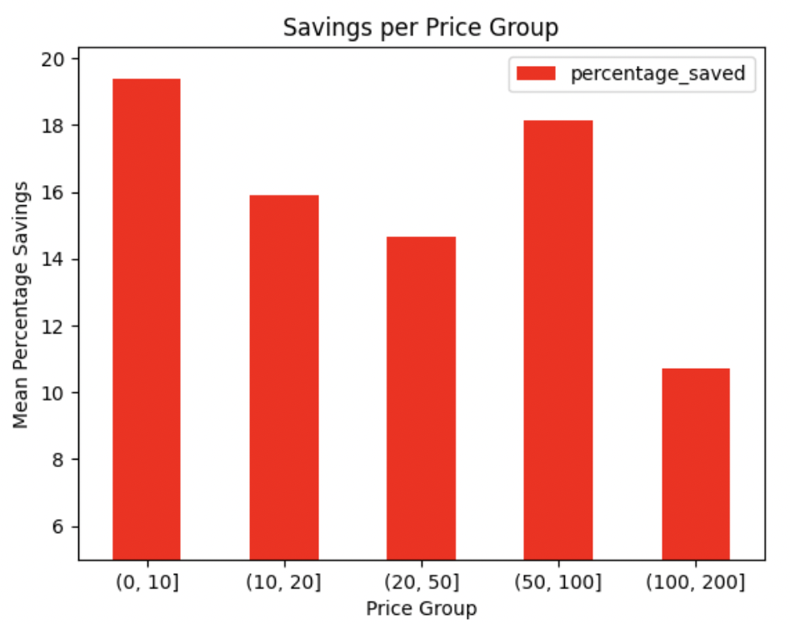
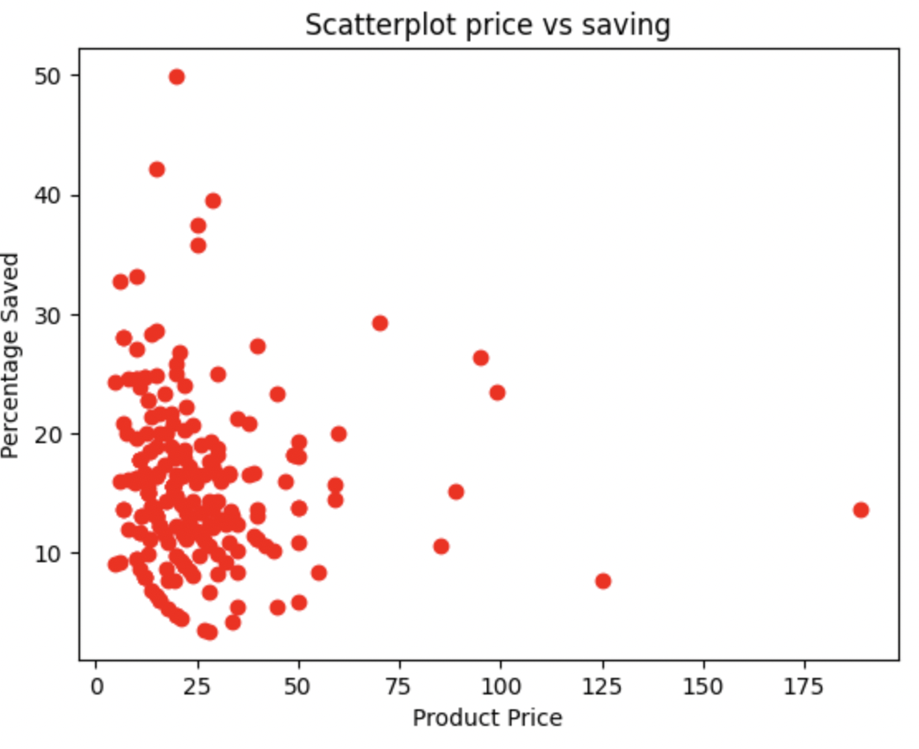
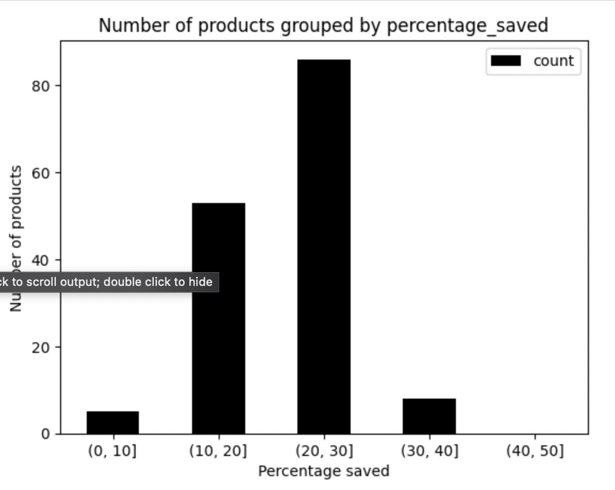
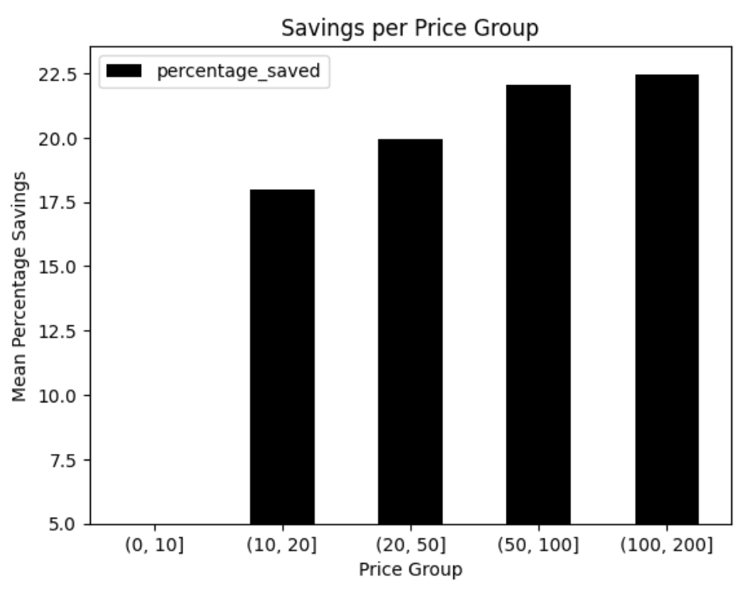
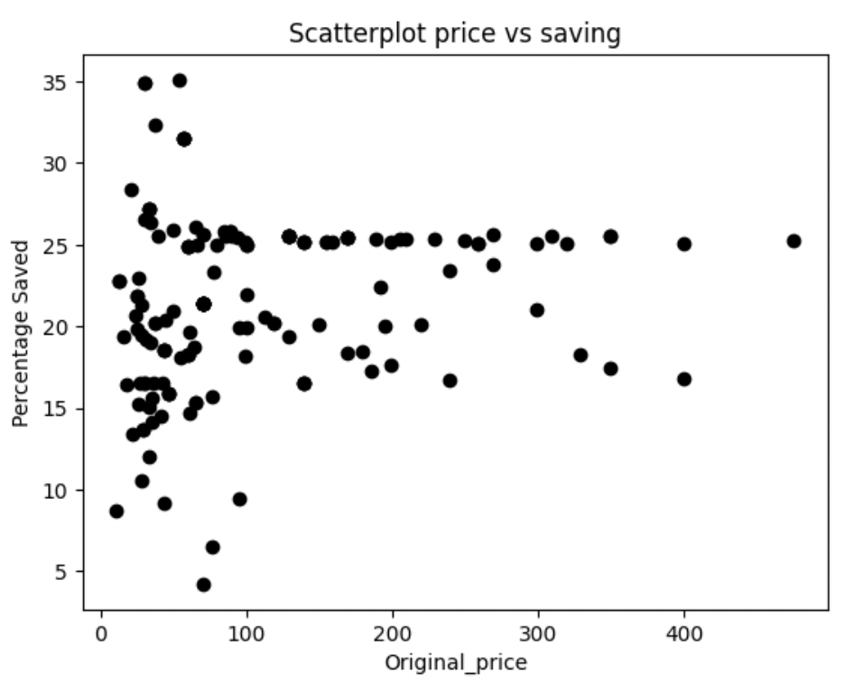
Data Analysis

Slide 10
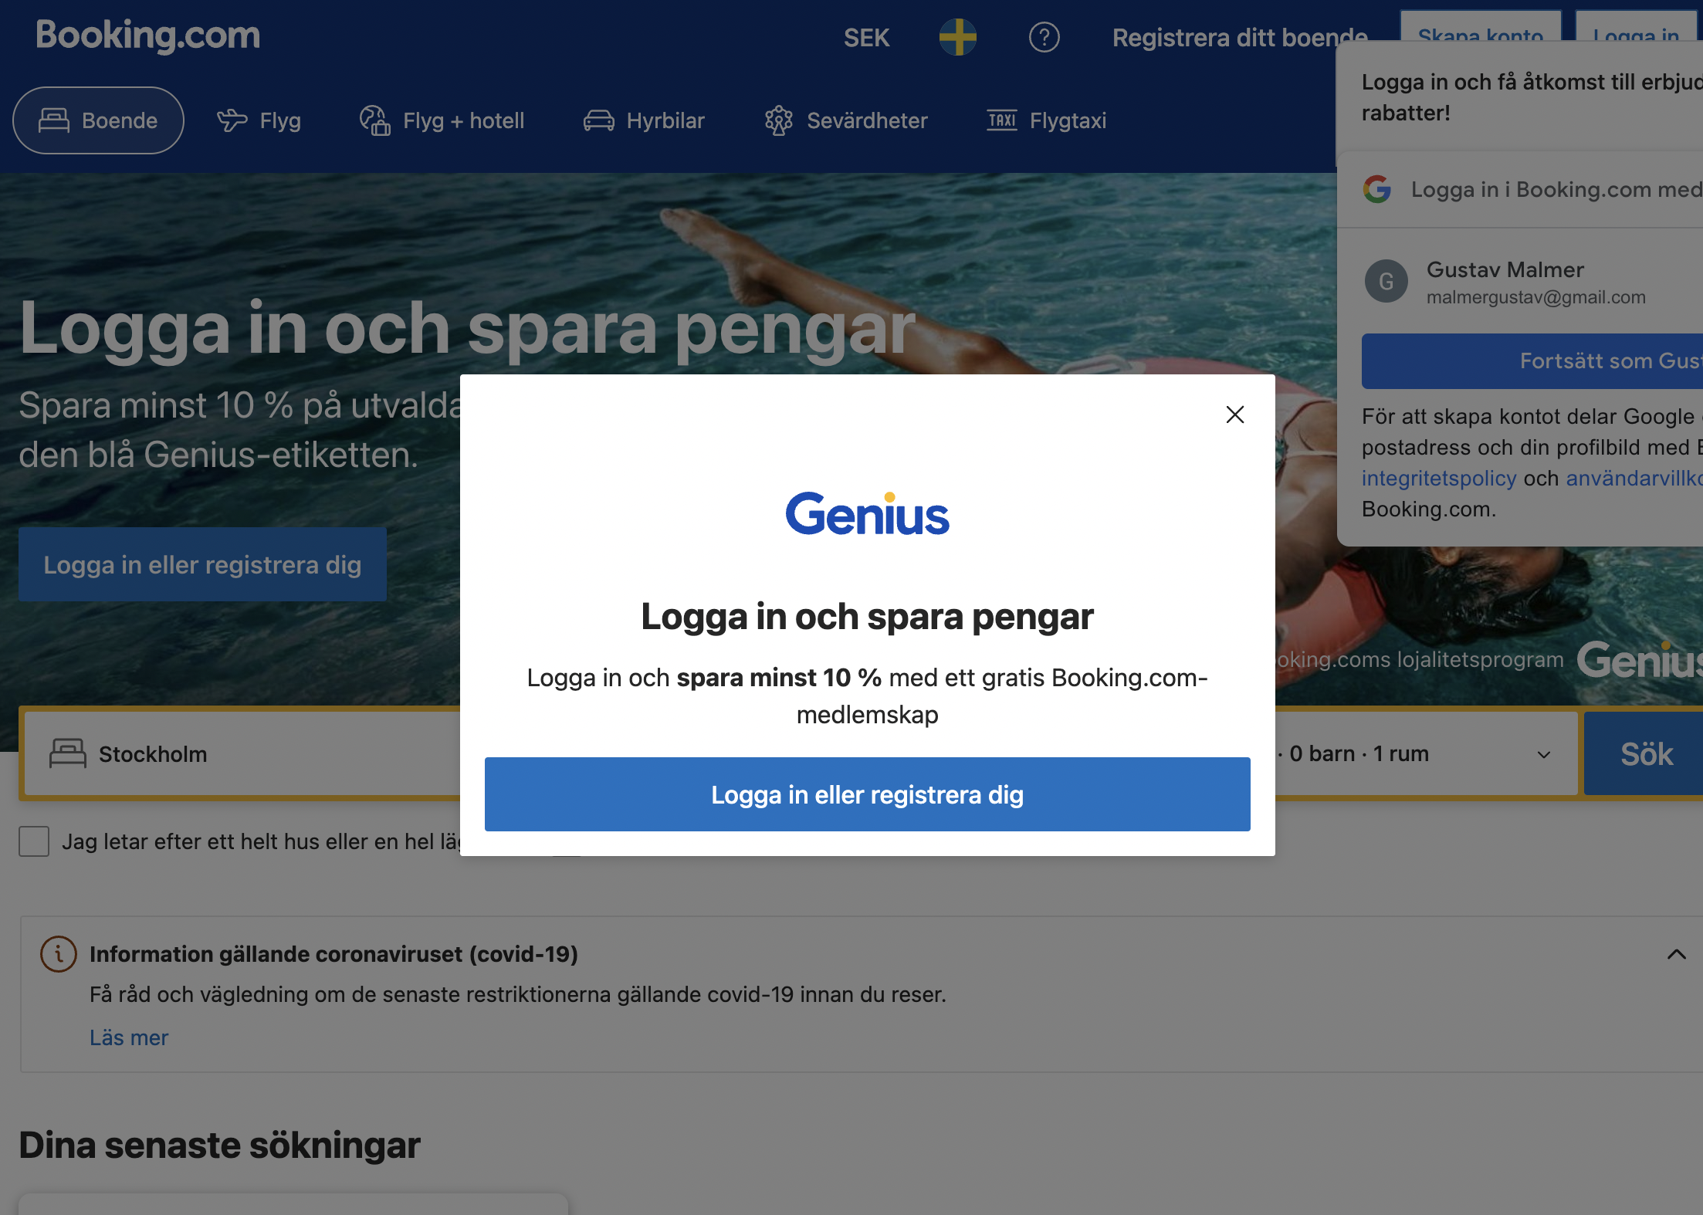

Learnings and mistakes
Choice of site
Scoping the project
NLP

